Slide 1

Toward phylodynamic inference from Typewriter lineage recordings
Antoine Zwaans & Sophie Seidel
09/09/2022
Sophie Seidel
30 June 2021, ISMB/ECCB
Notes:
Hello & thank you for joining
Present a framework to estimate
-> use single cell lineage tracing & rna seq data
→ to infer

Slide 2

Cellular processes during development
scRNA seq data gives us frequency of cell types
Lacks to inform the cell dynamics leading to these cell type frequencies
Notes:
There are still a lot of unknowns about the decision that cells take as they develop into a tissue or an organism – and how these decisions differ in diseased tissues.
If you think about it, if a cell divides it always leaves two offspring. And so the process of development can be thought of as a phylogenetic trees of cells along which cell state transitions happen. So questions about the developmental process are phylogenetic in nature.
In my PhD, I develop phylogenetic tools to learn about decisions that cells make during development. I am interested in the cellular dynamics: , e.g.
which cell type created the most of the cell mass in a tissue? What cell types can be created by another type? And when do cells comit to a certain type?
If we think about development on a cellular level, as cells progress from the zygote stage to a fully grown organism, there are 3 types of events
studies combining
scRNAseq + lineage tracing
abundance of cell types at t + what process gives rise to this abundance
For a single organism it is interesting
→ what process gives rise to this abundance
lineage tracing
– labels cells with evolving barcodes
basic idea: starting cell has unedited barcode, in time window CRISPR editing is inflicted, later timepoint cells are sampled
allows reconstruct the lineage hierarchy given the barcodes
scRNAseq
-> cell type composition at a single time point
from the lineage perspective – because we can explicitly capture cell division & death dynamics as well as the cell type changes

Slide 3
Aim
Use signal from joint lineage & scRNA measurements to estimate cell dynamics
i.e. division, apoptosis, differentiation
Notes:
There are still a lot of unknowns about the decision that cells take as they develop into a tissue or an organism – and how these decisions differ in diseased tissues.
If you think about it, if a cell divides it always leaves two offspring. And so the process of development can be thought of as a phylogenetic trees of cells along which cell state transitions happen. So questions about the developmental process are phylogenetic in nature.
In my PhD, I develop phylogenetic tools to learn about decisions that cells make during development. I am interested in the cellular dynamics: , e.g.
which cell type created the most of the cell mass in a tissue? What cell types can be created by another type? And when do cells comit to a certain type?
If we think about development on a cellular level, as cells progress from the zygote stage to a fully grown organism, there are 3 types of events
studies combining
scRNAseq + lineage tracing
abundance of cell types at t + what process gives rise to this abundance
For a single organism it is interesting
→ what process gives rise to this abundance
lineage tracing
– labels cells with evolving barcodes
basic idea: starting cell has unedited barcode, in time window CRISPR editing is inflicted, later timepoint cells are sampled
allows reconstruct the lineage hierarchy given the barcodes
scRNAseq
-> cell type composition at a single time point
from the lineage perspective – because we can explicitly capture cell division & death dynamics as well as the cell type changes

Slide 4
Outline
Phylodynamic inference
Typewriter
Features of the editing process
Model and likelihood calculation of the editing process

Slide 5
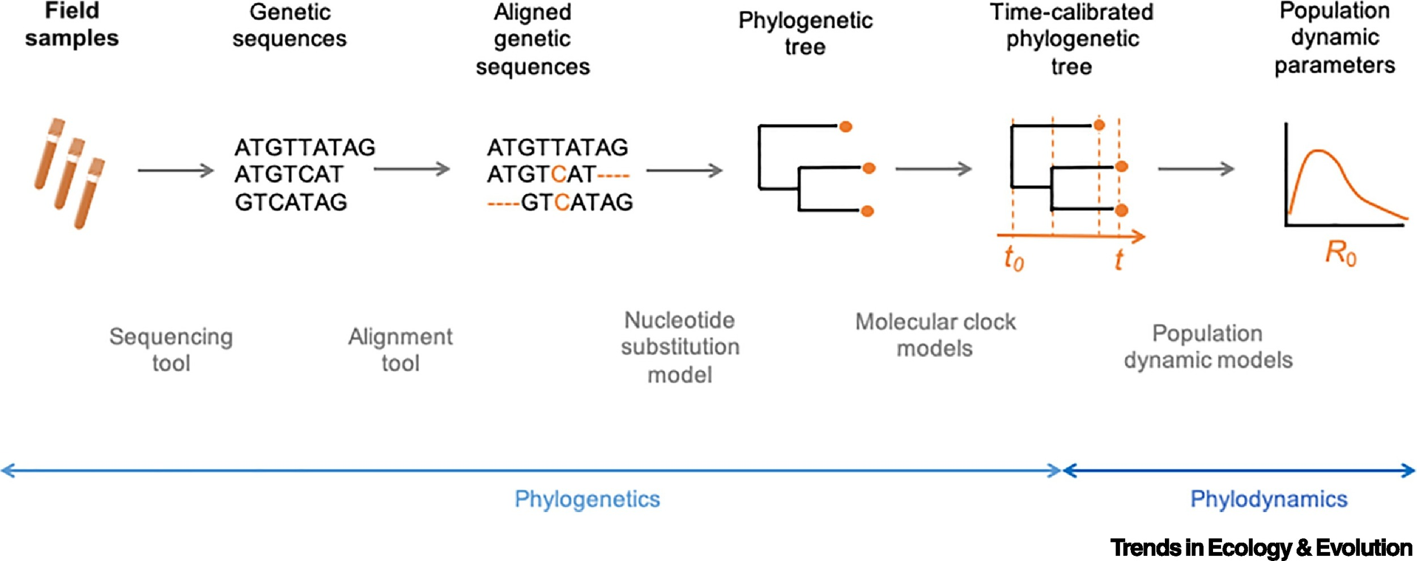
General workflow in phylodynamics

Slide 6
General workflow in phylodynamics
Develop substitution model for TypeWriter editing process

Slide 7
Outline
Phylodynamic inference
Typewriter
Features of the editing process
Model and likelihood calculation of the editing process

